Slide 1
Social Evolution in a Predator-Prey Model
Lena Payne (She/They), University of Kent, llp22@kent.ac.uk

Slide 2
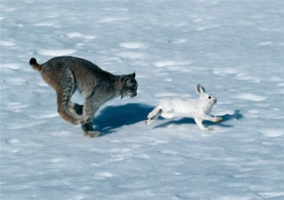
Introduction
My title is a lie.
Limited Evolution.
Prey only model.
Building a baseline.

Slide 3
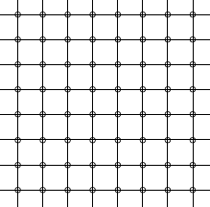
The Model (Spatial Structure)
Individual based model.
Square grids of a set size.
Discrete lattice with no boundaries.
Animals live in a doughnut shaped environment.

Slide 4
The Model (Temporal Structure)
Each simulation runs for 1000 time-steps.
Prey can begin to die of old age when they are 100 time-steps old.
Initial age distribution between 0 and 100.

Slide 5

The Model (Initialisation)
Set number of prey randomly dispersed on the lattice.
Each agent will try to move on the lattice.
Check to see if any prey have died.
Adjacent prey have a chance to reproduce.
New prey are dispersed.
Next time-step.

Slide 6
The Model (Potential Outcomes)
Three steady states
Extinction
Fully saturated
Unstable state

Slide 7
The Model (Variables)
Death Rate (1-0.95^{Age-100})
Lattice Size (5x5, 10x10, 15x15, 20x20, 25x25)
Initial Prey Density (0.1, 0.2 , …, 0.9, 1.0)
Reproduction Rate (4%, 2%, 1%, 0.5%, 0.25%)
5 iterations

Slide 8
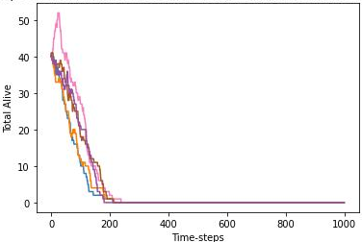
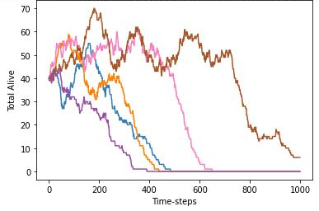
The Results (Extinction)
20x20, 0.1, 1%
10x10, 0.4, 1%

Slide 9

The Results (Saturation)

Slide 10
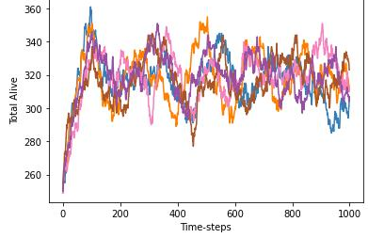
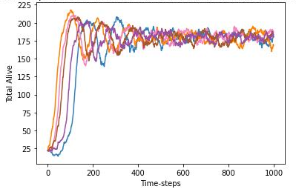
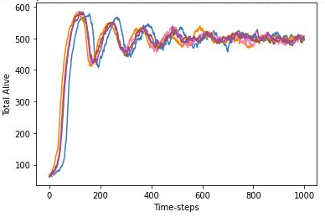
The Results (Unstable State)
Mean: 179-180
Variance: 64-124
Mean: 316-325
Variance: 107-168
Mean: 498-500
Variance: 576-623

Slide 11
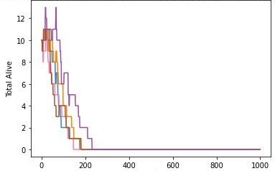
The Results (10x10, 2%)
Prey Density | Post Peak Averages | Average of Averages
0.1 | N/A | N/A

Slide 12
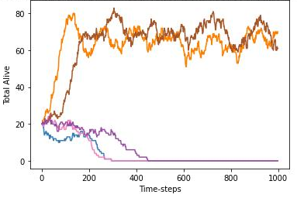
The Results (10x10, 2%)
Prey Density | Post Peak Averages | Average of Averages
0.1 | N/A | N/A
0.2 | 64,69 | 66.5

Slide 13
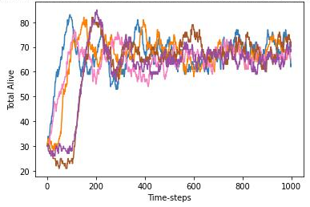
The Results (10x10, 2%)
Prey Density | Post Peak Averages | Average of Averages
0.1 | N/A | N/A
0.2 | 64,69 | 66.5
0.3 | 65,65,67,68,68 | 66.6

Slide 14
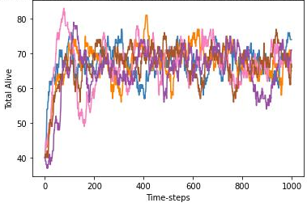
The Results (10x10, 2%)
Prey Density | Post Peak Averages | Average of Averages
0.1 | N/A | N/A
0.2 | 64,69 | 66.5
0.3 | 65,65,67,68,68 | 66.6
0.4 | 66,66,66,68,69 | 67

Slide 15
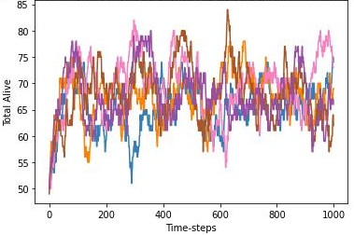
The Results (10x10, 2%)
Prey Density | Post Peak Averages | Average of Averages
0.1 | N/A | N/A
0.2 | 64,69 | 66.5
0.3 | 65,65,67,68,68 | 66.6
0.4 | 66,66,66,68,69 | 67
0.5 | 65,67,67,68,69 | 67.2

Slide 16
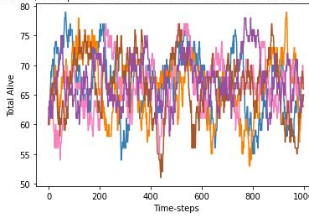
The Results (10x10, 2%)
Prey Density | Post Peak Averages | Average of Averages
0.1 | N/A | N/A
0.2 | 64,69 | 66.5
0.3 | 65,65,67,68,68 | 66.6
0.4 | 66,66,66,68,69 | 67
0.5 | 65,67,67,68,69 | 67.2
0.6 | 66,66,66,67,68 | 66.6

Slide 17
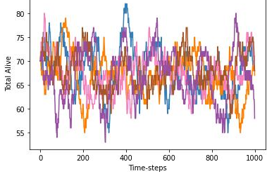
The Results (10x10, 2%)
Prey Density | Post Peak Averages | Average of Averages
0.1 | N/A | N/A
0.2 | 64,69 | 66.5
0.3 | 65,65,67,68,68 | 66.6
0.4 | 66,66,66,68,69 | 67
0.5 | 65,67,67,68,69 | 67.2
0.6 | 66,66,66,67,68 | 66.6
0.7 | 66,67,67,67,68 | 67

Slide 18
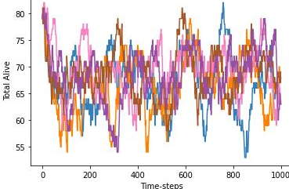
The Results (10x10, 2%)
Prey Density | Post Peak Averages | Average of Averages
0.1 | N/A | N/A
0.2 | 64,69 | 66.5
0.3 | 65,65,67,68,68 | 66.6
0.4 | 66,66,66,68,69 | 67
0.5 | 65,67,67,68,69 | 67.2
0.6 | 66,66,66,67,68 | 66.6
0.7 | 66,67,67,67,68 | 67
0.8 | 66,67,67,67,68 | 67

Slide 19
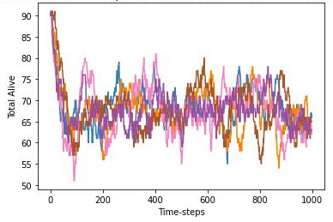
The Results (10x10, 2%)
Prey Density | Post Peak Averages | Average of Averages
0.1 | N/A | N/A
0.2 | 64,69 | 66.5
0.3 | 65,65,67,68,68 | 66.6
0.4 | 66,66,66,68,69 | 67
0.5 | 65,67,67,68,69 | 67.2
0.6 | 66,66,66,67,68 | 66.6
0.7 | 66,67,67,67,68 | 67
0.8 | 66,67,67,67,68 | 67
0.9 | 67,67,67,68,68 | 67.2

Slide 20
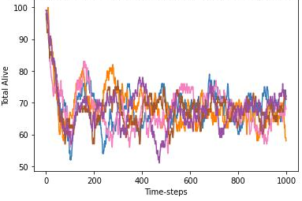
The Results (10x10, 2%)
Prey Density | Post Peak Averages | Average of Averages
0.1 | N/A | N/A
0.2 | 64,69 | 66.5
0.3 | 65,65,67,68,68 | 66.6
0.4 | 66,66,66,68,69 | 67
0.5 | 65,67,67,68,69 | 67.2
0.6 | 66,66,66,67,68 | 66.6
0.7 | 66,67,67,67,68 | 67
0.8 | 66,67,67,67,68 | 67
0.9 | 67,67,67,68,68 | 67.2
1.0 | 67,68,68,68,68 | 67.8

Slide 21
The Results (General Trends)
No 5x5 grids had a surviving population.
No surviving populations of 0.5% and 0.25%.
A higher reproduction rate results in a higher unstable steady state.
A larger lattice is weakly associated with higher survival rates, but NOT higher post peak averages.
Low and high prey densities take longer to become a steady state.
Initial prey density has a weak effect on post peak average.
Lower reproduction rate gives higher variance.

Slide 22
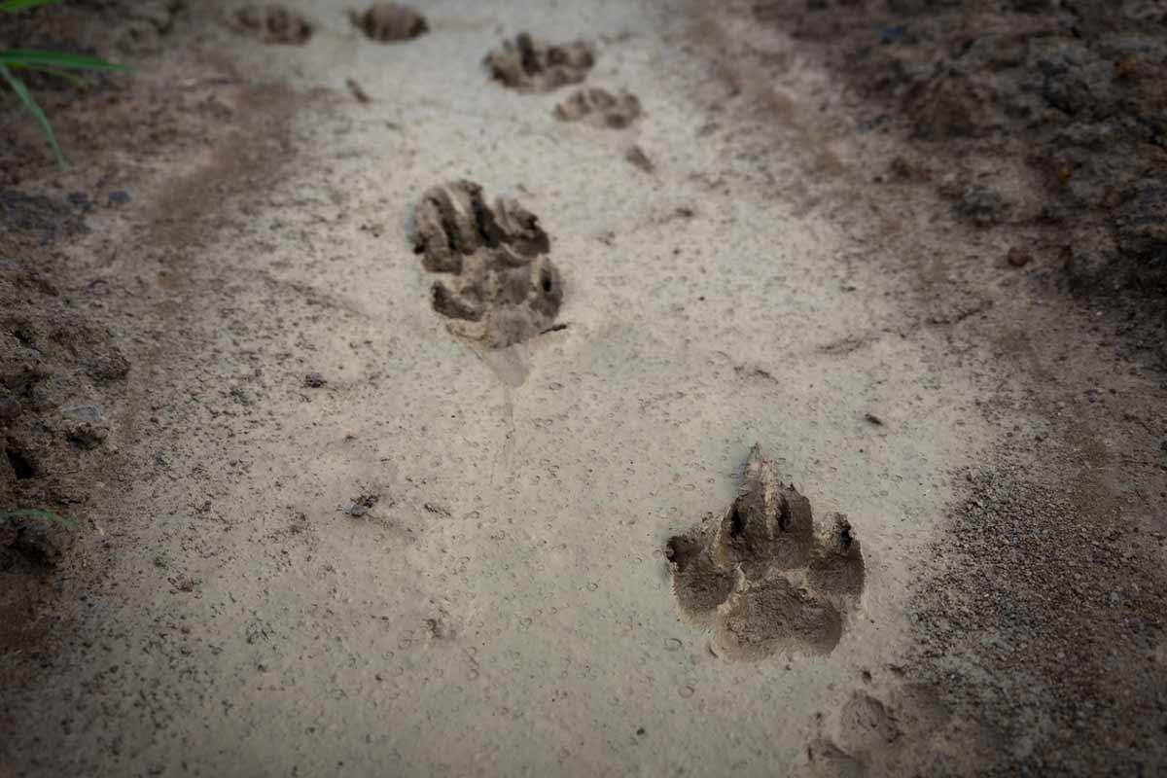

Where Next?
Biased movement
Put the predator back in predator-prey!

Slide 23
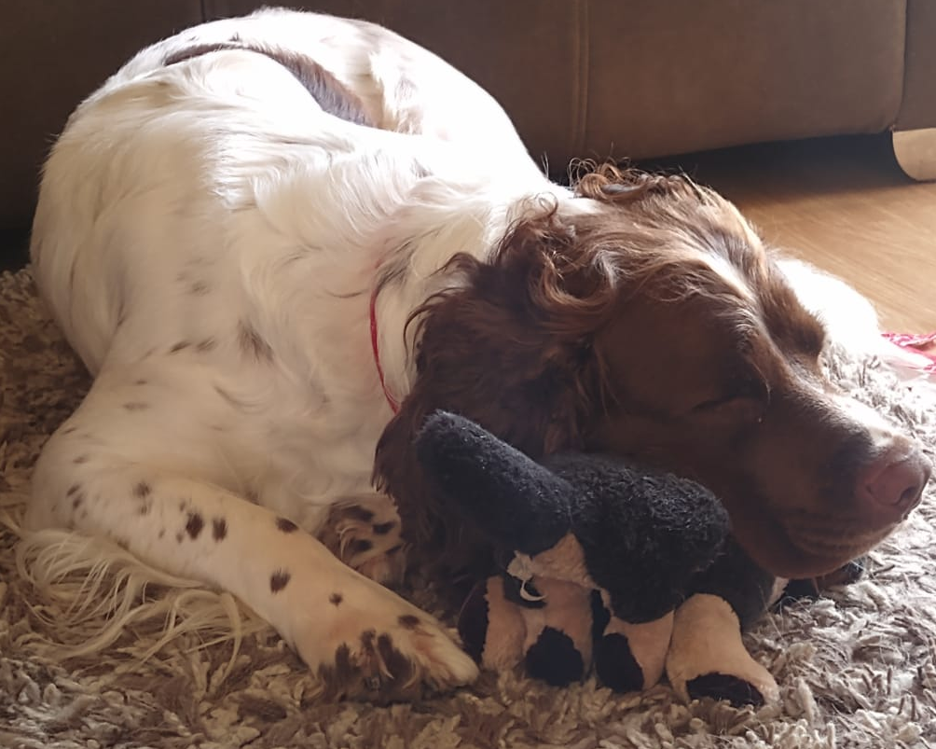

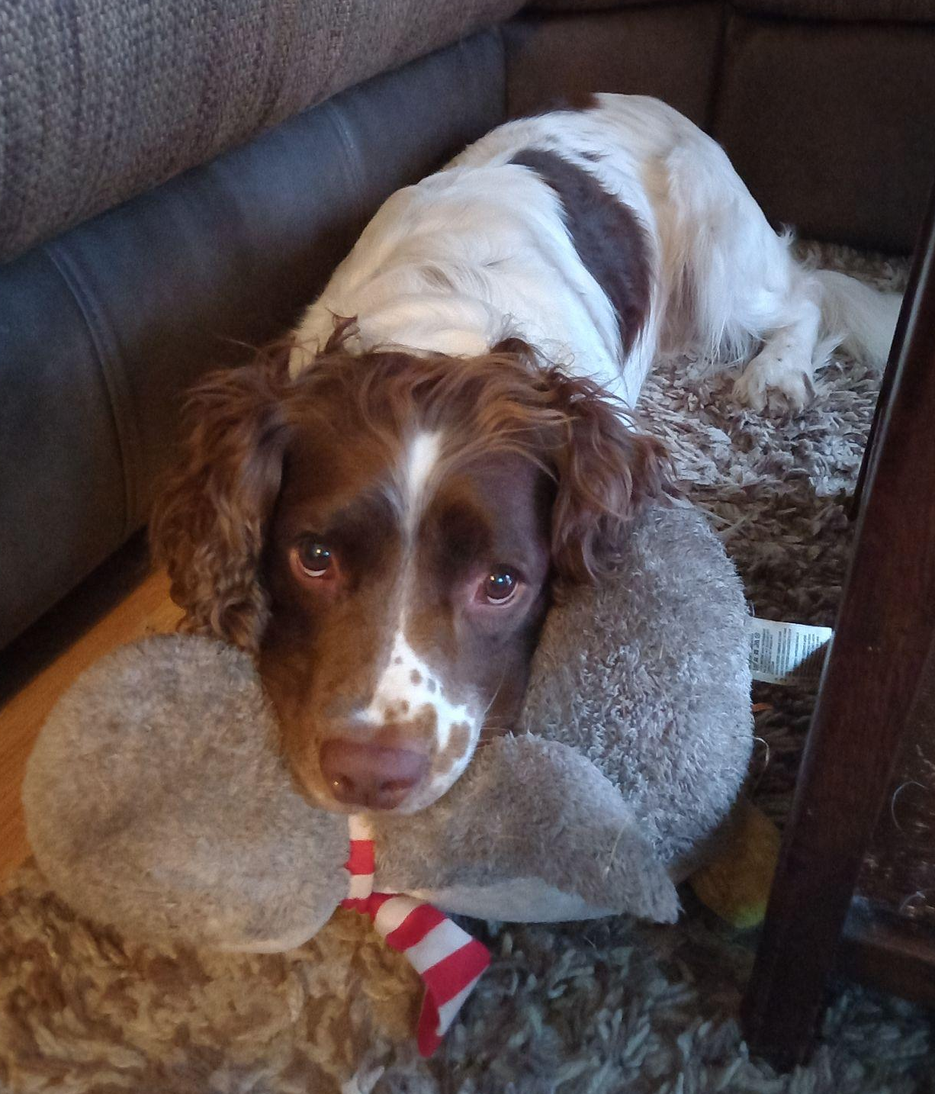
Thank You!

